Slide 1

Environmental Laboratory Informatics and Management System
Team LabRats
Julian Bell, Remy Brandriff, Maria Granroth
Mentor: Jun Rao

Slide 2
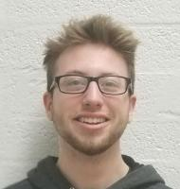


Julian Bell
Team Leader
Communications
Remy Brandriff
Architect
Webmaster
Maria Granroth
Document Editor
Meet the Team

Slide 3
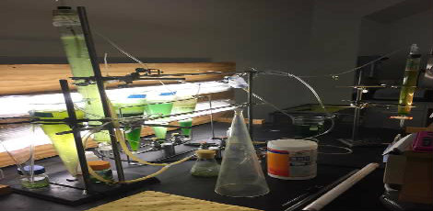
Background
NAU’s environmental engineering labs offer services to teaching, research, and special projects
Biotechnology and microbiology
Construction
Transportation
Water and soil
Data coming out of these labs
These labs use specified equipment and materials that can be potentially harmful and hazardous without proper organization and procedure, which is currently lacking

Slide 4
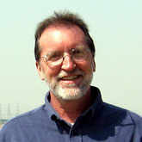
Client
Terry Baxter, PhD
Graduate of University of Kansas, Lawrence (1988)
NAU faculty since 1993
Associate professor in Environmental Engineering
Previous capstone mentor

Slide 5
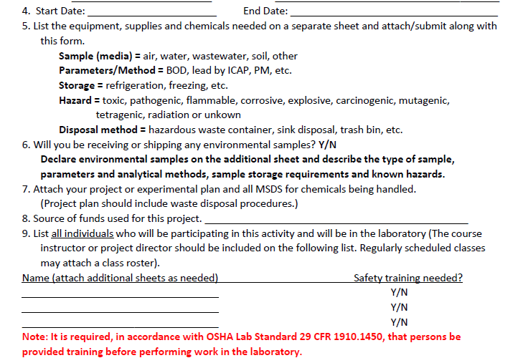
The Issues
Currently...
No organization
Lack of coordination
Conflicting uses
Potentially hazardous
There are potential conflicts in integration with existing systems and protocols that must be kept in mind during planning and development, as well as future applications

Slide 6
Solutions
Simplifies and integrates the existing process
Preserves face-to-face component
Works with the existing Environmental Health & Safety and ITS systems
Extensible
Robust inventory system
Needs to be able to be easily updated by ITS
Potentially used for commercial purposes by CENE in the future

Slide 7
Development Plan
Meet with client to walk through the existing process (keep fleshing plans out)
Correspond with ITS to figure out their requirements
Work out request system
Start interfacing with BioRaft
Integrate with inventory system
Chemical inventories, others, if possible

Slide 8
Summary
Original process
Request system?
ITS correspondence
Start interfacing with BioRaft
Inventory integration

Slide 9
Conclusion
The problem:
The lab management system doesn’t cut it
Safety standards
Planning
Improvements need to be made for longevity of system
The plan:
Build a robust web app to handle these requests
Sufficient inventory system for multiple purposes
ITS can keep maintaining the app for future years
Commercial avenues

